Slide 1
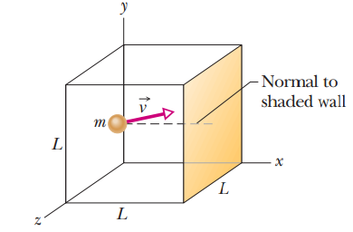
Lecture 6
Chapter 19: The Kinetic Theory of Gases
19-3 Pressure, temperature and rms speed :
Let n moles of an ideal gas be confined in a cubical box of volume V = L³ at temperature T.
The molecules of gas in the box are moving in all directions and with various speeds and consider only elastic collisions with the walls.

Slide 2


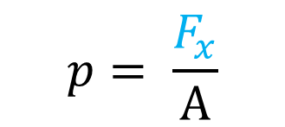
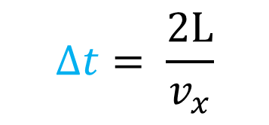
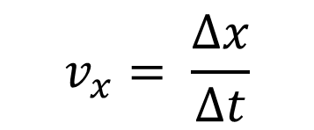

One molecule: 1D (x-axis)
$$p= \frac{F_{x}}{A}$$
$p$ = $\frac{\frac{Δp_{x}}{Δt}}{A}$
$Δ\vec{px} =\vec{pxf}−\vec{pxi}=m{(−v}_{x })−m{(+v}_{x })$ $={−mv}_{x }−mv_{x }={−2mv}_{x }$
$Δp_{x}=$ ${2mv}_{x }$
$$v_{x}= \frac{Δx}{Δt}$$
$$Δt= \frac{2L}{v_{x}}$$
$${A=L^{2}}_{ }$$

Slide 3
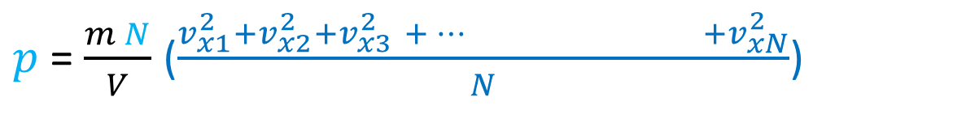
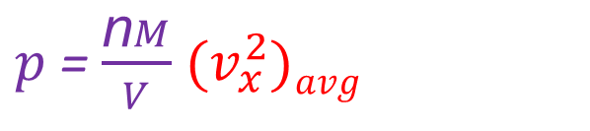
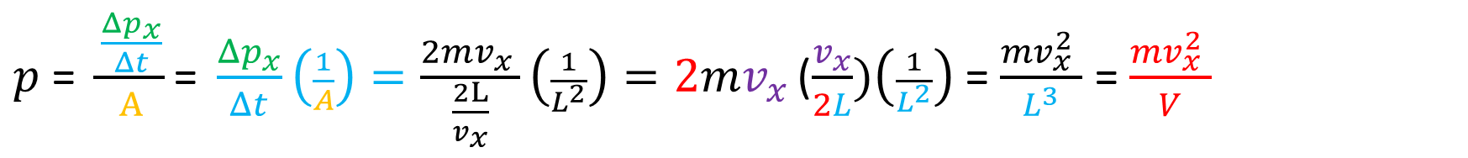
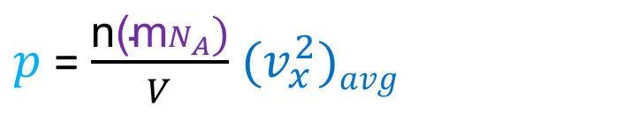
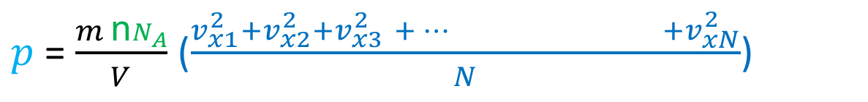
$p$ = $\frac{\frac{Δp_{x}}{Δt}}{A}\text{=} \frac{Δp_{x}}{Δt}\left(\frac{1}{A}\right)=\frac{{2mv}_{x }}{\frac{2L}{v_{x}}}\left(\frac{1}{L^{2}}\right)={2mv}_{x }$($\frac{v_{x}}{2L})\left(\frac{1}{L^{2}}\right)$ = $\frac{{mv}_{x}^{2} }{L^{3}}$ = $\frac{{mv}_{x}^{2} }{V}$
N molecules: 1D (x-axis) N = n$N_{A}$ and M = m$N_{A}$
$p$= $\frac{{m v}_{x}^{2} }{V}$ = $\frac{m}{V}$(${{v_{x1}^{2}+v}_{x2}^{2}+v}_{x3}^{2}$ ${+… +v}_{xN}^{2}$)
$p$= $\frac{m N}{V}$ ($\frac{{{v_{x1}^{2}+v}_{x2}^{2}+v}_{x3}^{2} {+… +v}_{xN}^{2}}{N}$)
$p$= $\frac{m \text{n}N_{A}}{V}$ ($\frac{{{v_{x1}^{2}+v}_{x2}^{2}+v}_{x3}^{2} {+… +v}_{xN}^{2}}{N}$)
$p$= $\frac{\text{n}\text{(}\text{m}N_{A}\text{)}}{V}$ ${(v}_{x}^{2})avg$
$p$= $\frac{\text{n}M}{V}$ ${(v}_{x}^{2})avg$

Slide 4

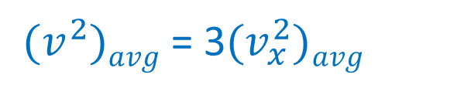

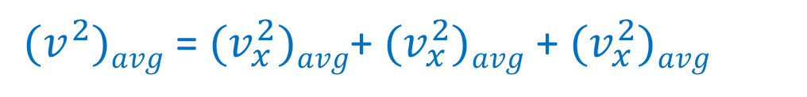

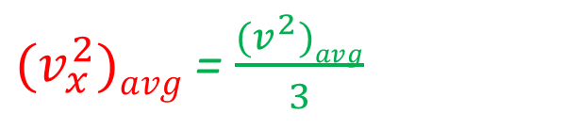
N molecules (not an ideal gas): 3D (x, y, z - axes)
$$v^{2}={{v_{x}^{2}+v}_{y}^{2}+v}_{z}^{2}$$
${(v}^{2})avg$ = ${(v}_{x}^{2})avg$+ ${(v}_{y}^{2})avg$ + ${(v}_{z}^{2})avg$
$${[v}_{x }=v_{y }=v_{z }]$$
${(v}^{2})avg$ = ${(v}_{x}^{2})avg$+ ${(v}_{x}^{2})avg$ + ${(v}_{x}^{2})avg$
${(v}^{2})avg$ = 3${(v}_{x}^{2})avg$
${(v}_{x}^{2})avg$ = $\frac{{(v}^{2})avg}{3}$

Slide 5
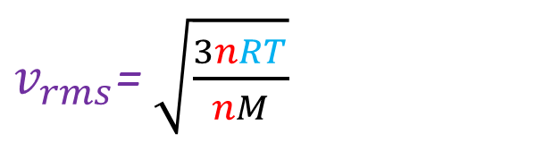
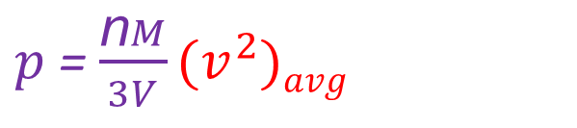
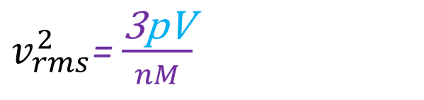
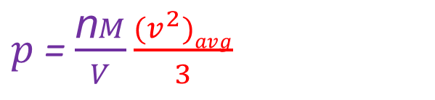
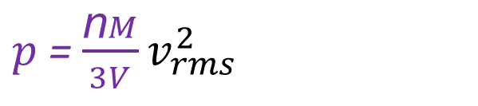
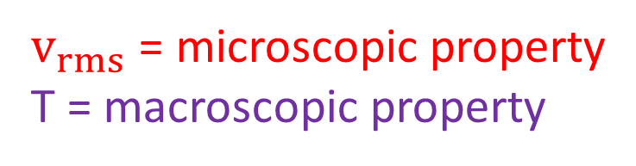



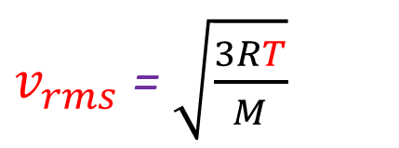
$p$= $\frac{\text{n}M}{V}\frac{{(v}^{2})avg}{3}$
$p$= $\frac{\text{n}M}{3V}$ ${(v}^{2})avg$
$$vrms=√{(v}^{2})avg$$
$$v_{rms}^{2}={(v}^{2})avg$$
$p$= $\frac{\text{n}M}{3V}v_{rms}^{2}$
$v_{rms}^{2}$= $\frac{\text{3}\text{pV}}{nM}$
$$\text{Ideal} \text{gas}\text{, }\text{pV}\text{ = }\text{nRT}$$
$v_{rms}$= $\sqrt{\frac{3nRT}{nM}}$
$v_{rms}$ = $\sqrt{\frac{3RT}{M}}$
$v_{rms}$ = microscopic property
T = macroscopic property
This is the relation between the rms speed of a microscopic property and the temperature of a macroscopic property.

Slide 6


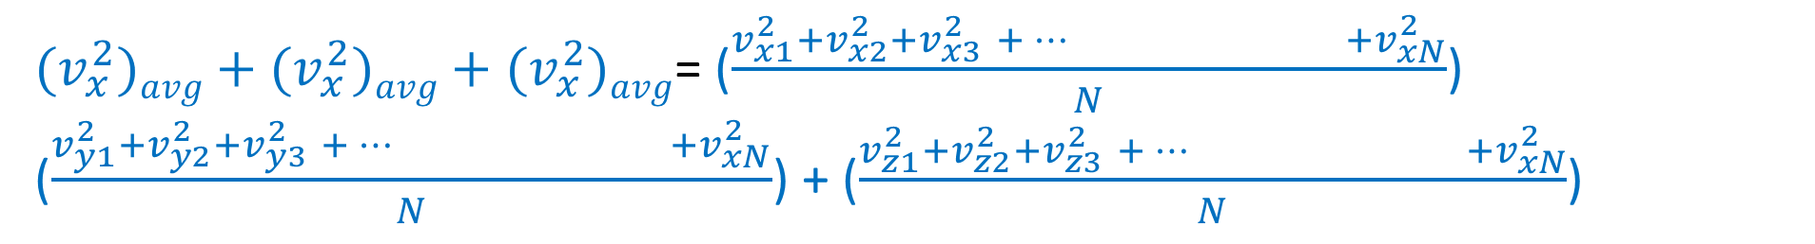

${(v}_{x}^{2})avg{ + (v}_{x}^{2})avg{ + (v}_{x}^{2})avg$= ($\frac{{{v_{x1}^{2}+v}_{x2}^{2}+v}_{x3}^{2} {+… +v}_{xN}^{2}}{N}$) ($\frac{{{v_{y1}^{2}+v}_{y2}^{2}+v}_{y3}^{2} {+… +v}_{xN}^{2}}{N}$) + ($\frac{{{v_{z1}^{2}+v}_{z2}^{2}+v}_{z3}^{2} {+… +v}_{xN}^{2}}{N}$)
$$v^{2}={{v_{x}^{2}+v}_{y}^{2}+v}_{z}^{2}$$
$$vrms=√{(v}^{2})avg$$
$$v_{rms}^{2}={(v}^{2})avg$$

Slide 7
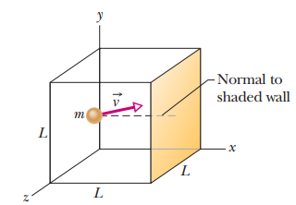




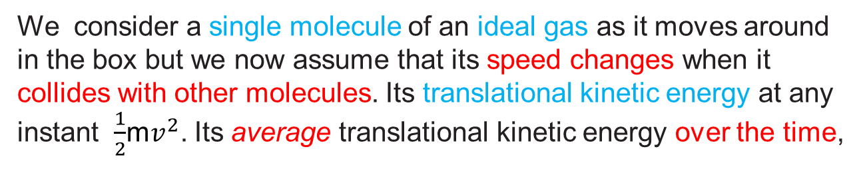
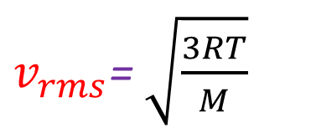
19-4 Translational kinetic energy :
We consider a single molecule of an ideal gas as it moves around in the box but we now assume that its speed changes when it collides with other molecules. Its translational kinetic energy at any instant $\frac{1}{2}$m$v^{2}$. Its average translational kinetic energy over the time,
$$vrms=√{(v}^{2})avg$$
$$v_{rms}^{2}={(v}^{2})avg$$
$v_{rms}$= $\sqrt{\frac{3RT}{M}}$

Slide 8


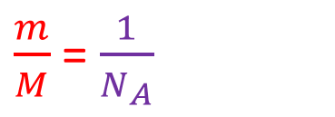
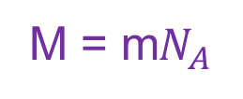
M = m$N_{A}$
$\frac{m}{M}$= $\frac{1}{N_{A}}$
Boltzmann constant, k = R/N_{A}
The average kinetic energy of an atom is a function of temperature.

Slide 9
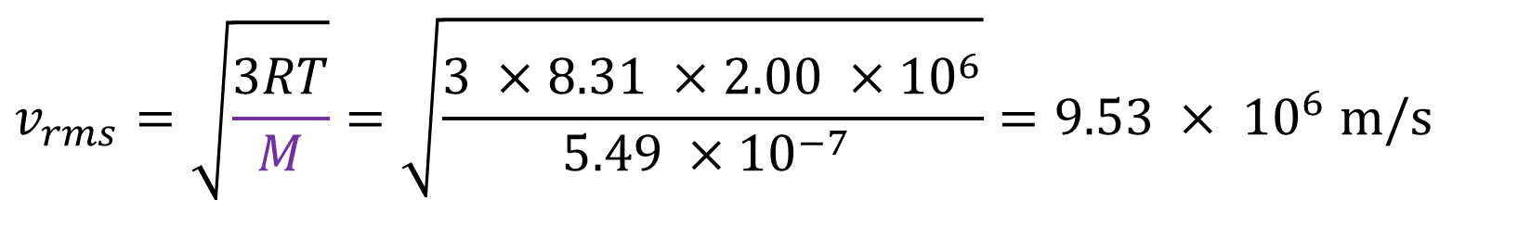

Problem 18:
The temperature and pressure in the Sun’s atmosphere are 2.00x10⁶ K and 0.0300 Pa. Calculate the rms speed of free electrons (mass 9.11x10⁻³¹ kg) there, assuming they are an ideal gas.
Solution:
$$v_{rms}=\sqrt{\frac{3RT}{M}}=\sqrt{\frac{3 ×8.31 ×2.00 ×{10}^{6}}{5.49 ×{10}^{−7} }}=9.53 × {10}^{6} m/s$$
$$v_{rms}=95, 00000 m/s$$
M = m$N_{A}$ = 9.11x10⁻³¹ (6.023X10²³)= $5.49 ×{10}^{−7 }$kg

Slide 10
Problem 25
Determine the average value of the translational kinetic energy of the molecules of an ideal gas at temperatures (a) 0.00 ⁰C and (b) 100 ⁰C. What is the translational kinetic energy per mole of an ideal gas at (c) 0.00 ⁰C and (d) 100 ⁰C?
Solution:
(a) K_{avg}$per molecule=\left(\frac{3}{2}\right)kT=\frac{3}{2}\left(\frac{R}{N_{A}}\right)T=\frac{3}{2} ×\frac{8.314}{6.022 ×{10}^{23}} \left(273.0\right)=5.654 ×{10}^{−21}J$
(b) K_{avg}$per molecule=\left(\frac{3}{2}\right)kT=\frac{3}{2}\left(\frac{R}{N_{A}}\right)T=\frac{3}{2} ×\frac{8.314}{6.022 ×{10}^{23}} \left(373.0\right)=7.724 ×{10}^{−21}J$
(c) K_{avg}$per mole=Kavg NA=5.654 ×{10}^{−21} x 6.022 ×{10}^{23}$= 3405 J
(d) K_{avg}$per mole=Kavg NA=7.724 J ×{10}^{−21} x 6.022 ×{10}^{23}$= 4651 J

